Slide 1
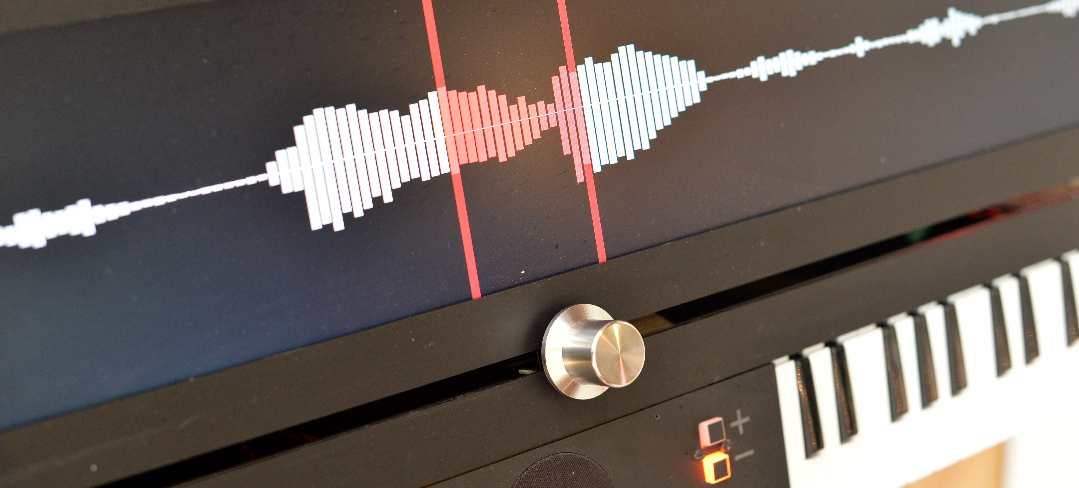





Automatic Music Audio-to-Score Transcription with
Deep Neural Networks
Lele Liu
Supervisors: Emmanouil Benetos, Veronica Morfi, and Simon Dixon
AIM forum, Oct 30, 2021

Slide 2
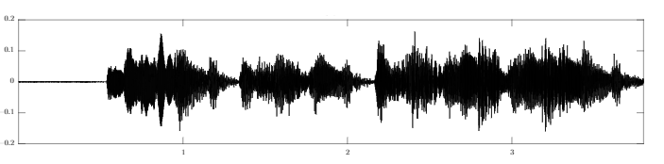
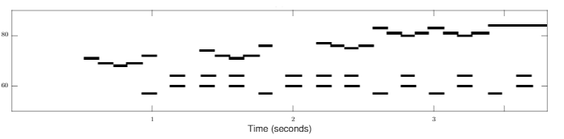
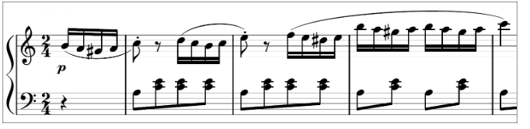
Problem Definition >> Background >> Progress >> Proposed Work >> Time Plan
Problem Definition
Multi-pitch detection
Output format: piano-roll
Score transcription
Output format: music score

Slide 3
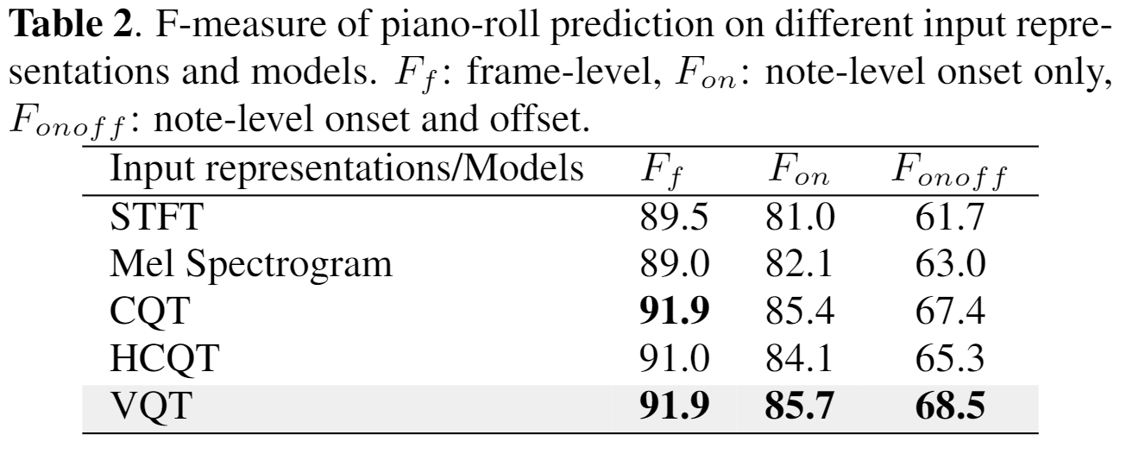
Problem Definition >> Background >> Progress >> Proposed Work >> Time Plan
Time-Frequency Representation Comparison
A comparison between different time-frequency representations (STFT, Mel spectrogram, CQT, HCQT and VQT¹) and their different parameters
Performance evaluated on a multi-pitch detection task with a Convolutional Recurrent Neural Network (CRNN) network architecture
Results evaluated on MIREX multi-pitch detection metric on the synthesized dataset
VQT shows the best performance, with a γ value of 20 and 8 octaves × 60 bins per octave in the frequency axis
¹ STFT: Short-Time Fourier Transform; CQT: Constant-Q Transform; HCQT: Harmonic Constant-Q Transform; VQT: Variable-Q Transform

Slide 4
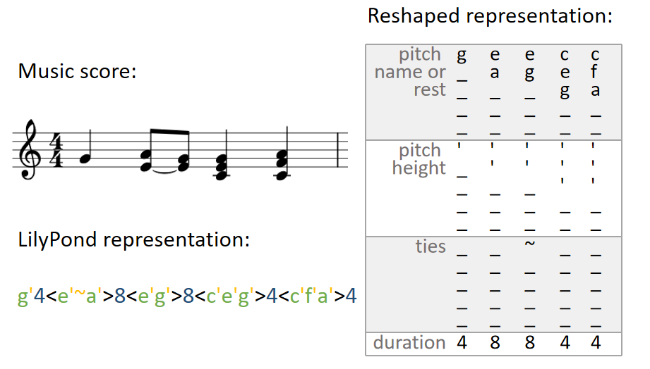
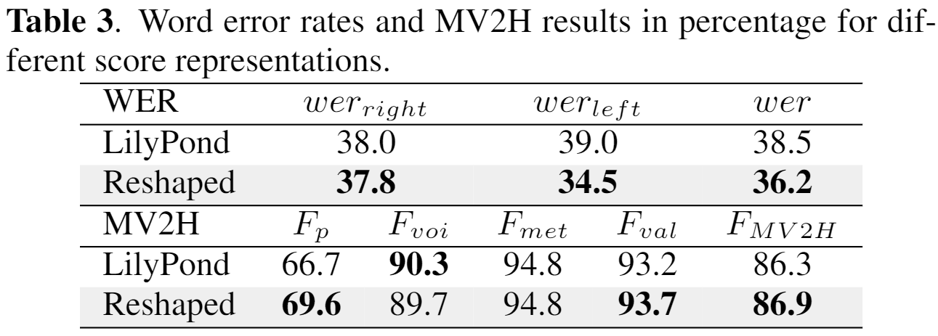
Problem Definition >> Background >> Progress >> Proposed Work >> Time Plan
Proposed Score Representation
LilyPond representation vs. Proposed Reshaped representation
Model combined with a convolutional network and two attentional sequence-to-sequence models for right and left hand score prediction.
Model performance tested on the synthesized dataset.
The Reshaped representation also outperforms the LilyPond representation in terms of the time and memory resources required (around 7 times faster and half the memory)
MV2H: Andrew Mcleod and Mark Steedman. Evaluating Automatic Polyphonic Music Transcription. In ISMIR, pages 42–49, 2018.

Slide 5
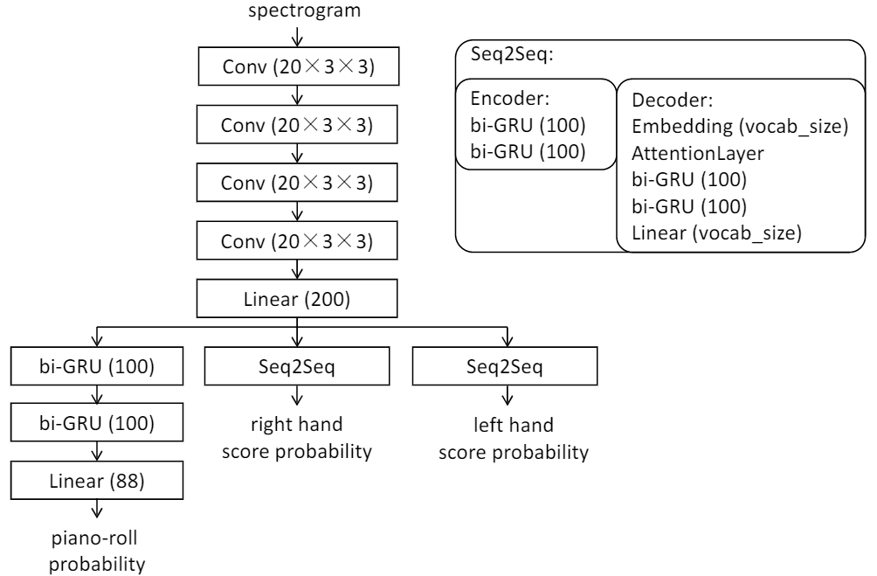
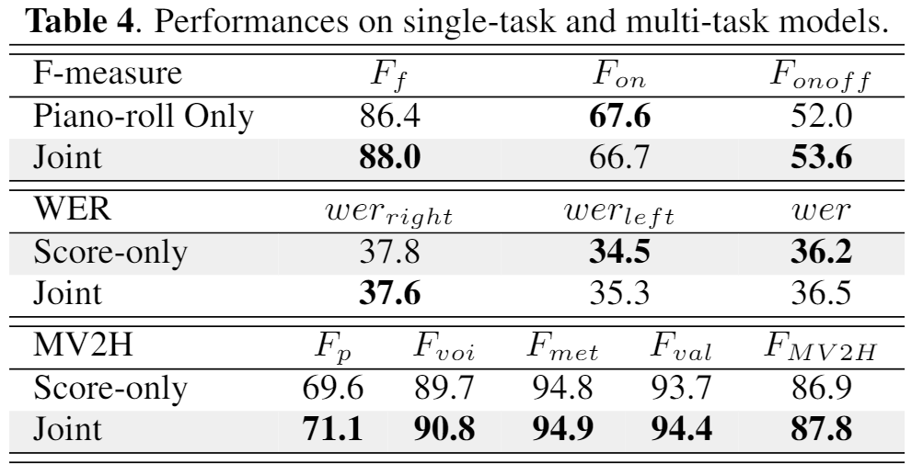
Problem Definition >> Background >> Progress >> Proposed Work >> Time Plan
Joint Multi-pitch Detection & Score Transcription
Model architecture (attention implementation follows Bahdanau et al. 2015):
The Joint model generally outperforms the single task models.

Slide 6
ACPAS Dataset >> Dataset Content >> Download Dataset
ACPAS Dataset
497 distinct music scores aligned with 2189 audio performances.
Currently the largest dataset for audio-to-score transcription, to our knowledge.
Aligned performance audio, performance MIDI and MIDI scores, together with beat, key signature, and time signature annotations
A train/validation/test split with no piece overlap and in line with splits in other automatic music transcription datasets
Statistics across subsets and splits
Subset/Split | Distinct Pieces | Performances | Duration (hours)
Real recording | 215 | 578 | 49.0
Synthetic | 497 | 1611 | 130.8
train | 359 | 1523 | 127.7
validation | 49 | 184 | 11.2
test | 89 | 482 | 40.9
Total | 497 | 2189 | 179.8
6
Notes:
The ACPAS dataset / is created specifically / for audio-to-score transcription tasks.
It contains / nearly 500 distinct music scores / aligned with over 2000 audio performances,
And / is currently the largest dataset / for audio-to-score transcription, to our knowledge.
We provide aligned performance audio, performance MIDI and MIDI scores,
together with the beat, key signature, and time signature annotations.
We specifically provide a train/validation/test split / where there is no piece overlap across splits /
and in line with splits / in other automatic music transcription datasets,
such as the MAPS dataset / and the MAESTRO dataset.
Table 1 shows some basic dataset statistics.

Slide 7
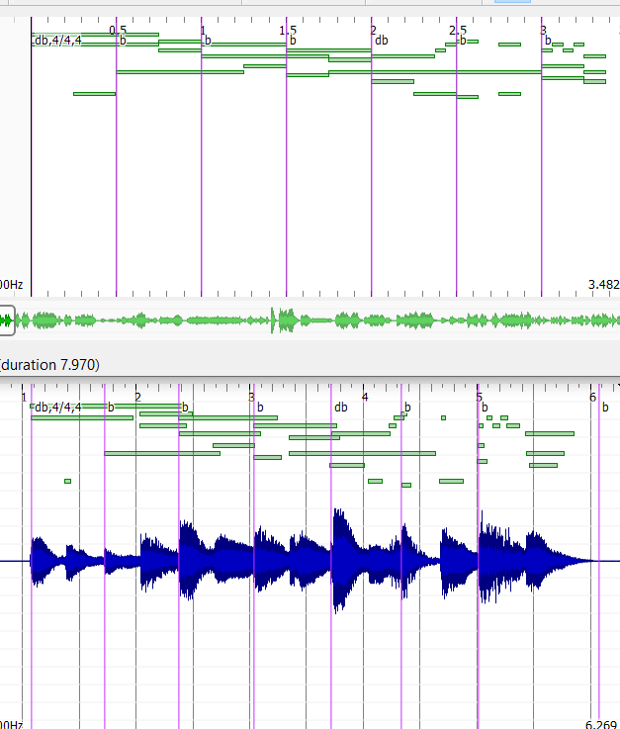
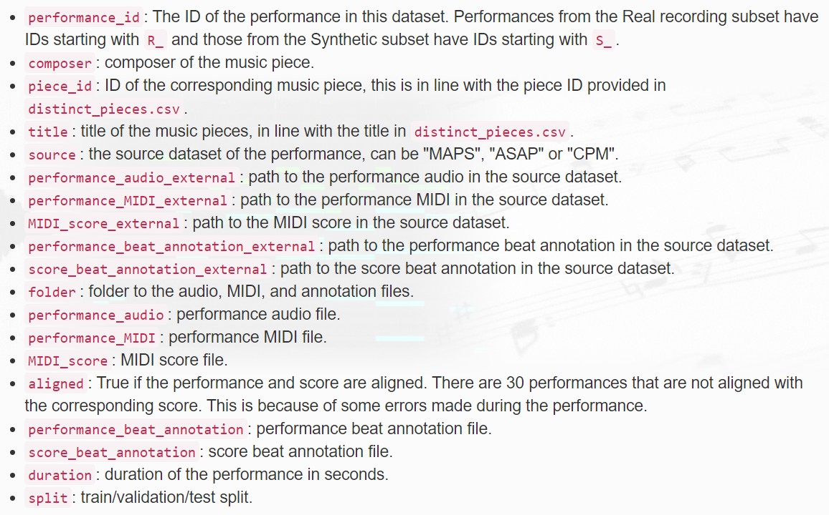
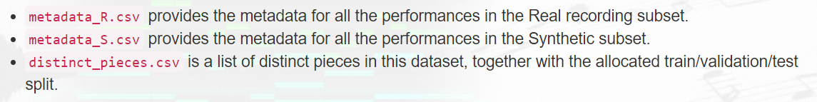
ACPAS Dataset >> Dataset Content >> Download Dataset
Dataset Content
We collected data from three sources
the MAPS^{[1]} and A-MAPS^{[2]} dataset
the Classical Piano MIDI^{[3]} (CPM) database
the ASAP^{[4]} dataset
Two subsets
Real recording subset
Synthetic subset
Synthesis process
Four different piano fonts in Native Instrument Kontakt Player^{[5]}
Monaural audio files in .wav format, 44.1kHz, 16 bit
Notes:
On creating the dataset, we collected data / from three sources.
The MAPS dataset, the Classical Piano MIDI database, and the ASAP dataset.
We divided the dataset / into a real recording subset / and a synthetic subset,
so that people / can develop and evaluate models / under different conditions.
To create missing audio performances / from the sources,
we synthesize audio recordings / from performance MIDI / using Native Instrument Kontakt Player.
We used four different piano fonts / to introduce some variations.
The newly synthesized audio files / are monaural and provided in .wav format, CD quality.
We provide metadata for performances / in each subset, and / a list of all distinct pieces.
The performance metadata / covers information / such as distinct piece ID, paths to the performance, score, and annotation files, and the assigned train/validation/test split.
Beat, key signature and time signature annotations / are provided in text files.

Slide 8
ACPAS Dataset >> Dataset Content >> Download Dataset
Next steps
Automatic performance MIDI to quantized MIDI conversion (internship project)
Modelling longer sequence using enhanced model architecture and larger dataset
Cross-domain audio-to-score transcription
Feedback and contact:
Email: lele.liu@qmul.ac.uk
Website: https://cheriell.github.io
Thank you for your attention!
Notes:
On creating the dataset, we collected data / from three sources.
The MAPS dataset, the Classical Piano MIDI database, and the ASAP dataset.
We divided the dataset / into a real recording subset / and a synthetic subset,
so that people / can develop and evaluate models / under different conditions.
To create missing audio performances / from the sources,
we synthesize audio recordings / from performance MIDI / using Native Instrument Kontakt Player.
We used four different piano fonts / to introduce some variations.
The newly synthesized audio files / are monaural and provided in .wav format, CD quality.
We provide metadata for performances / in each subset, and / a list of all distinct pieces.
The performance metadata / covers information / such as distinct piece ID, paths to the performance, score, and annotation files, and the assigned train/validation/test split.
Beat, key signature and time signature annotations / are provided in text files.

